Slide 1
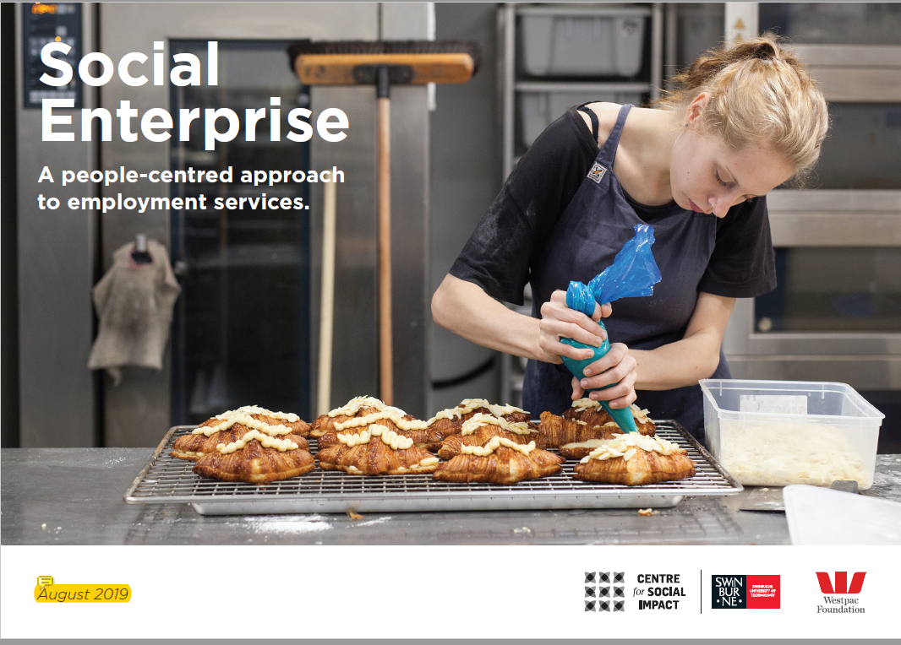
Lisa Waldron, Westpac Foundation and Joanne Qian, CSI-S

Slide 2
Westpac Foundation’s goal is to help change 100,000 lives for the better and help social enterprises create 10,000 jobs in Australia by 2030.

Slide 4
The ripple effect of a job is powerful
The individual has a sense of belonging and purpose, families and communities are stronger, and so is society.
Notes:
The ripple effect of a job is powerful.
When social enterprises like Jigsaw give people like Chem a job, we leverage all of the talent available to our country. The individual has a sense of belonging and purpose, families and communities are stronger, and so is society.

Slide 5
Do employment-focused social enterprises provide a pathway out of disadvantage? An evidence review
Research questions
Key findings
Impacts of employment: a pathway out of disadvantage
Employment-focused social enterprises as an alternative approach
How effective are social enterprise employment pathways

Slide 6
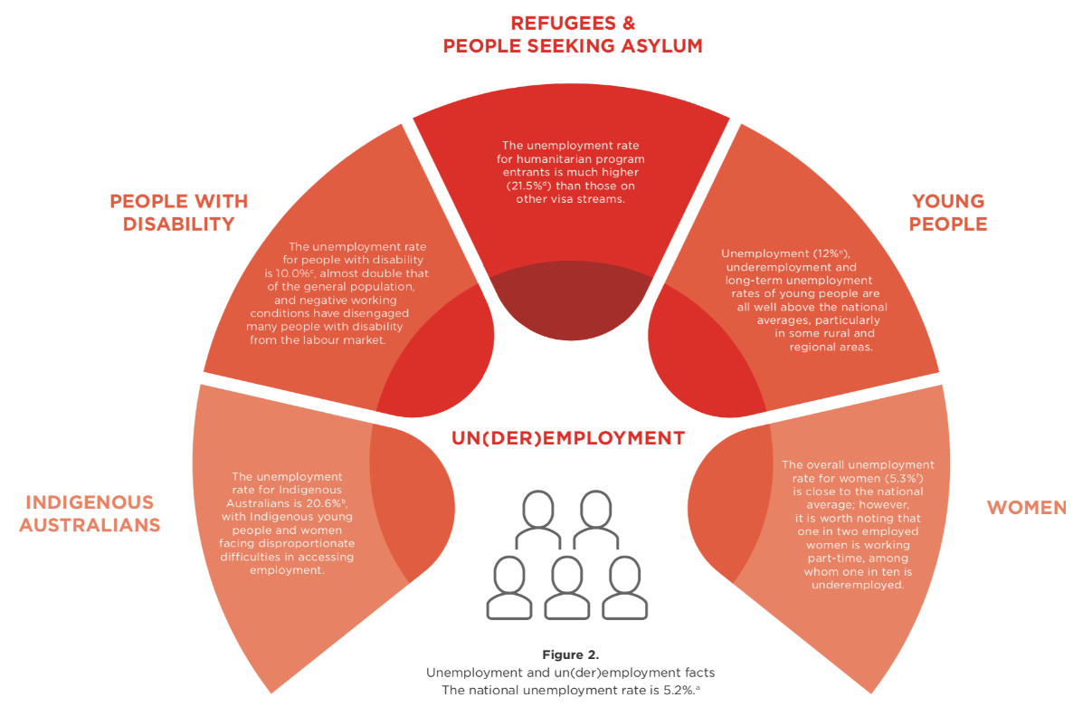
Impacts of employment: a pathway out of disadvantage
Theoretic underpinning
The individual value of employment
The social value of employment
Empirical evidence
Benefits of employment, or negative impacts of un(der)employment
Importance to meaningful employment

Slide 7
Employment-focused social enterprise: an alternative approach to mainstream solutions
Demand for meaningful employment in Australia
The important role that employment-focused social enterprises are playing to support people experiencing disadvantage

Slide 8
How effective are social enterprise employment pathways?
Employment outcomes
Individual-level employment outcomes
Community-level employment outcomes
Effective social enterprise model
Increased work experience
Increased skills
Enhanced self-esteem and self-efficacy
Changes to identity
Increased sense of belonging
Increased income
Economic regeneration
Community hubs
Increased community equity and cohesion
People centred
Integrative
Adaptive
Collaborative
Economics benefits of employment-focused social enterprises
Challenges for economic measures
Studies on labour productivity, costs, and social benefits of employment-focused social enterprises

Slide 9
Implications and discussion
To support social enterprises to grow and scale, we need to further develop our knowledge on:
Community level outcomes
The longer term social impacts
The organisational mechanisms
Call for future research:
Comparative studies and longitudinal studies
Social finance options
Challenges and opportunities for employment-focused social enterprises
Philanthropy and social enterprise in Australia
Measuring employment outcomes

Slide 10
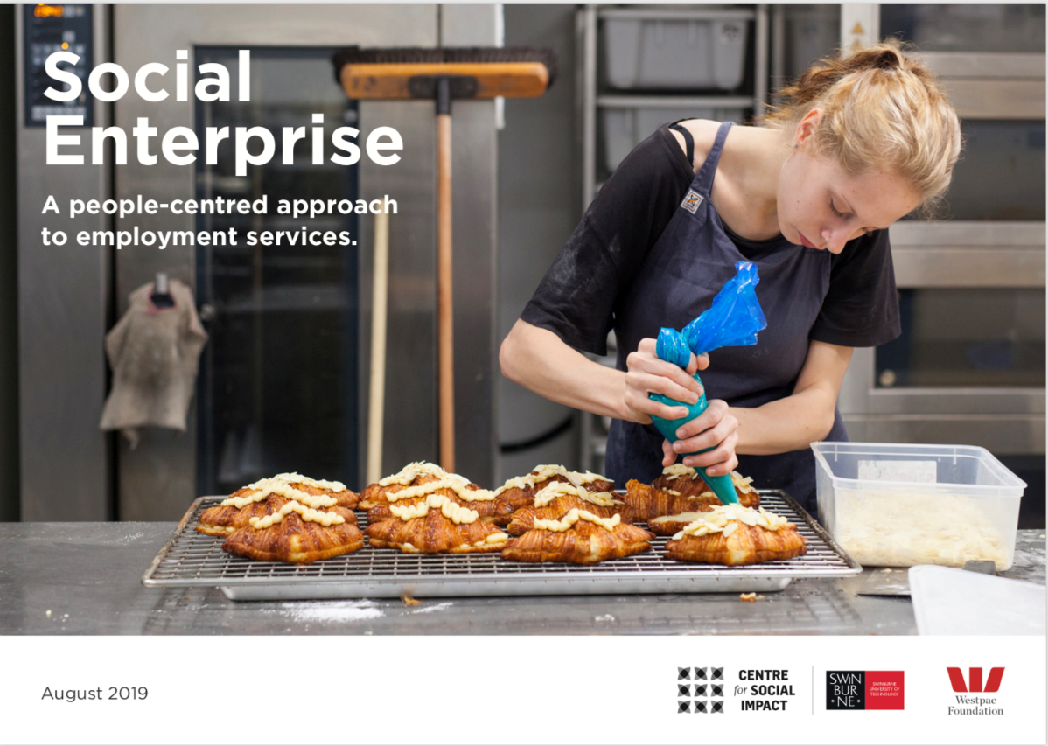
Research output
Summary report:
https://www.westpac.com.au/news/in-depth/2019/08/why-social-job-gains-mean-so-much/
Full evidence review:
Qian, Joanne; Riseley, Emma and Barraket, Jo. (2019). Do employment-focused social enterprises provide a pathway out of disadvantage? An evidence review. Australia: The Centre for Social Impact Swinburne
Available at https://apo.org.au/node/251711

